Slide 1
Analysis and Design of Algorithms
Huffman Compression for Bmp, Jpg, png Images to produce text file
PRESENTED BY: Kasyapa Sai Deepak(St122891)
August 2022

Slide 2
CONTENTS
Introduction
Objectives
Working
Future Work
References

Slide 3
INTRODUCTION
Huffman coding is a method of data compression that is independent of the data type, that is, the data could represent an image, audio or spreadsheet.

Slide 4
INTRODUCTION
Huffman Compression is used for compressing the text files.
Also, for the audio, image files -- compression can be done using Huffman coding.
Here, we discuss about the image compression using Huffman.
And mainly, with converting the image file , it also gives output as a text file containing image data

Slide 5
INTRODUCTION
This Program Specially functions to produce the Text file of Compressed input Data by taking the Input Image

Slide 6
OBJECTIVES
Here, we give input as an image and info about the pixel data.
For each pixel data , the dictionary is created. Then Combines into heap and merges into Huffman tree
Finally, we want to get a Text file containing the compressed image data.

Slide 7
Working
Algorithms and Data Structures used:
Dynamic Programming – Huffman
Dictionaries
Heap
Merge Sort

Slide 8
Expected Results and outputs
We Can input Any type of images(jpg, bmp, png)
Pixel data of an image is stored
Compression time can be seen
Image is compressed and shows up
Text file is generated and we can see the compressed data.

Slide 9
Working
Firstly , we create two classes for the program
Initialize them with the variables
We define the class Heap node and Picture

Slide 10
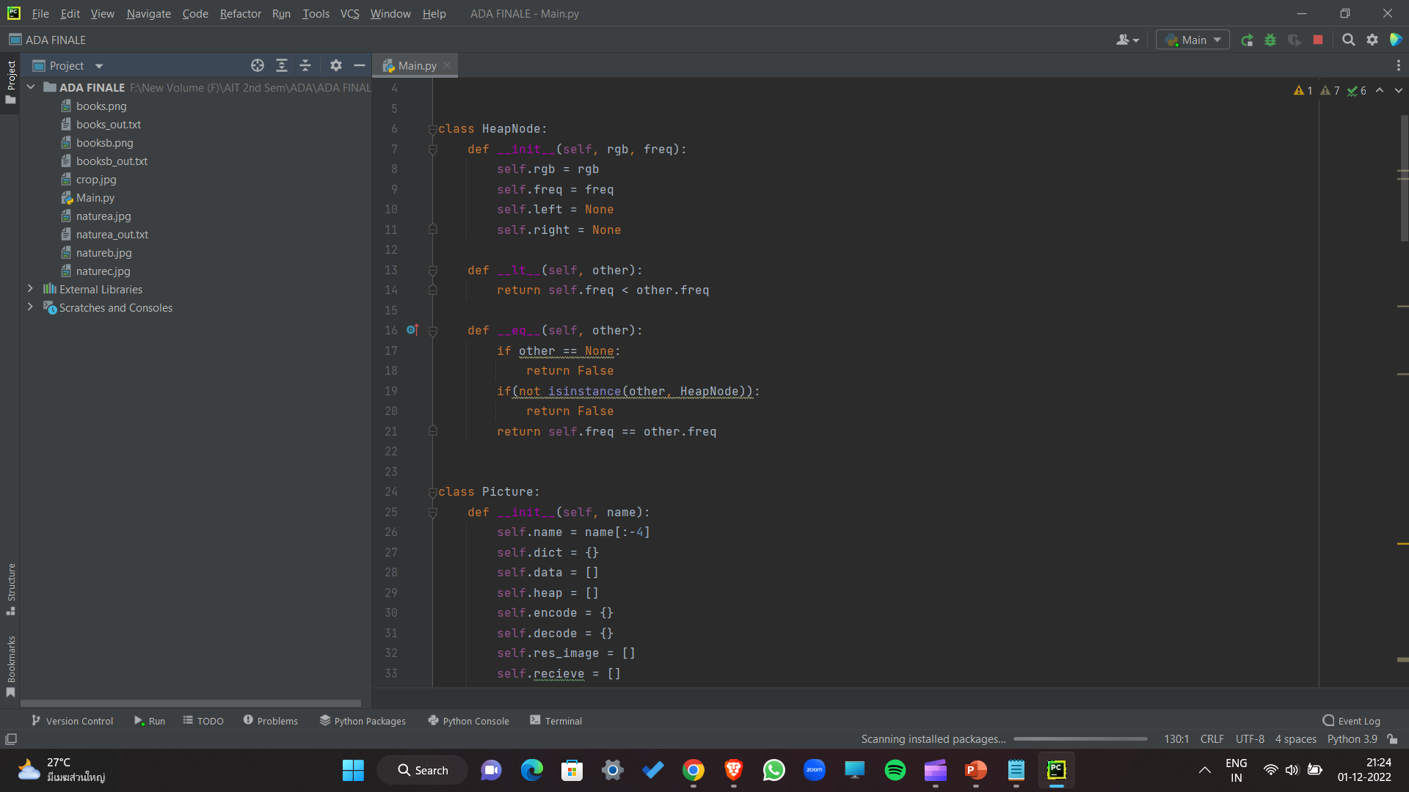

Working
Firstly , we create two classes for the program

Slide 11
Using Dictionary:
Then ,For each pixel data , the dictionary is created.
Next, a heap is constructed basis for Dictionary.

Slide 12
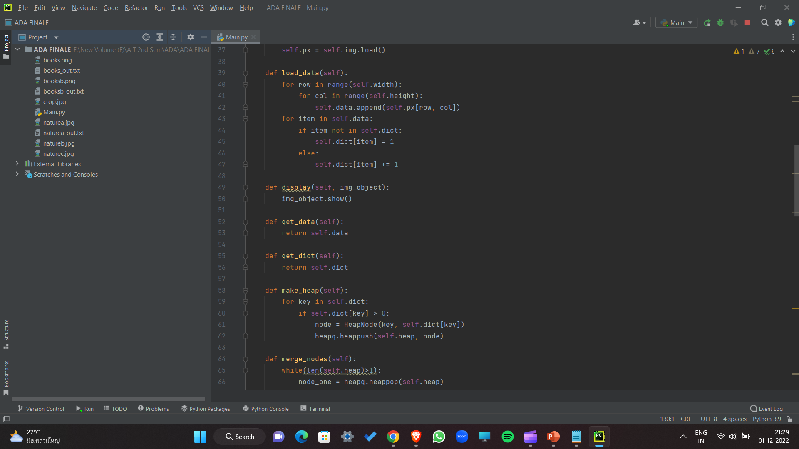

Slide 13
Using the Merge Sort:
After, it we Recursively merge the heap elements of the node into a
Huffman tree
Then, Perform Traversing for Huffman tree to generate the encoded strings

Slide 14
Huffman Tree:
Huff Tree is generated
Then , again using the dictionary to encode the strings for it.

Slide 15
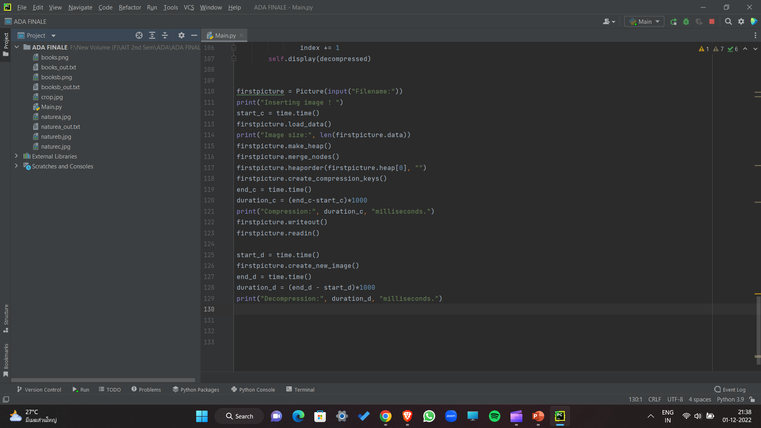

Slide 16
Run the terminal and Input the image

Slide 17
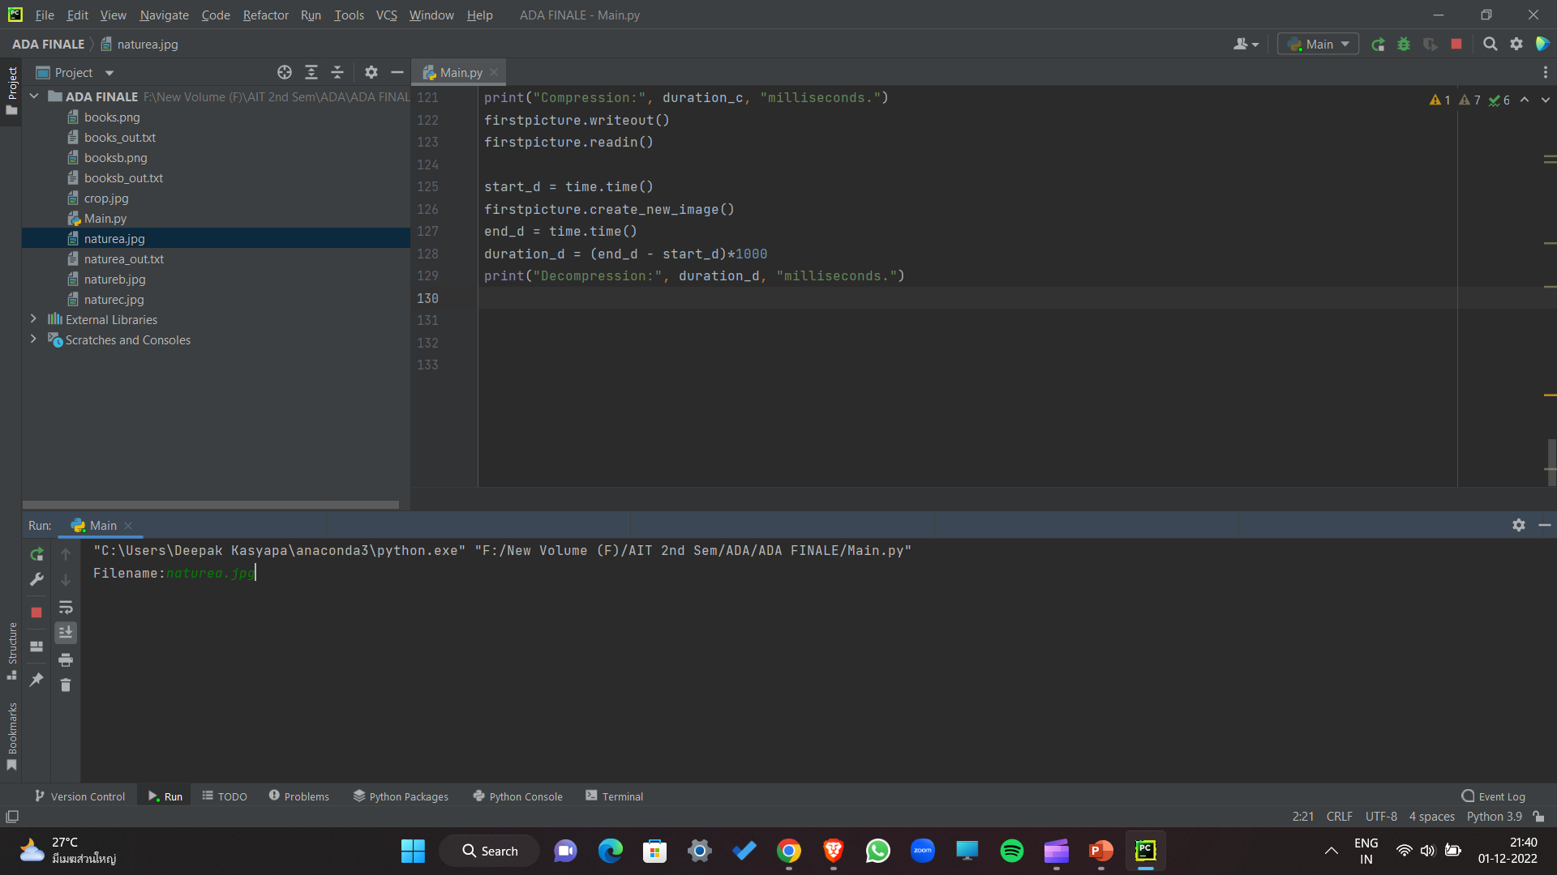


Slide 18
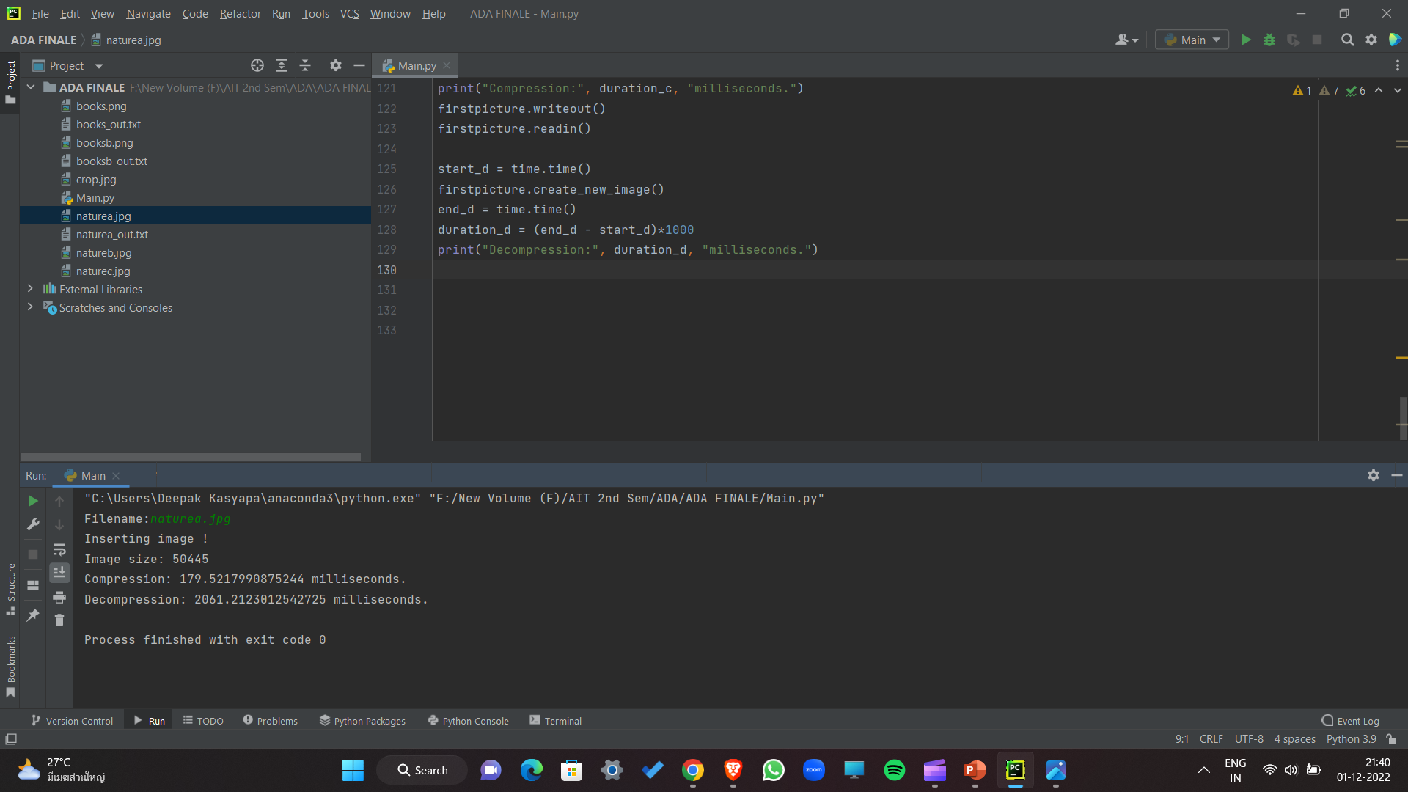


Slide 19
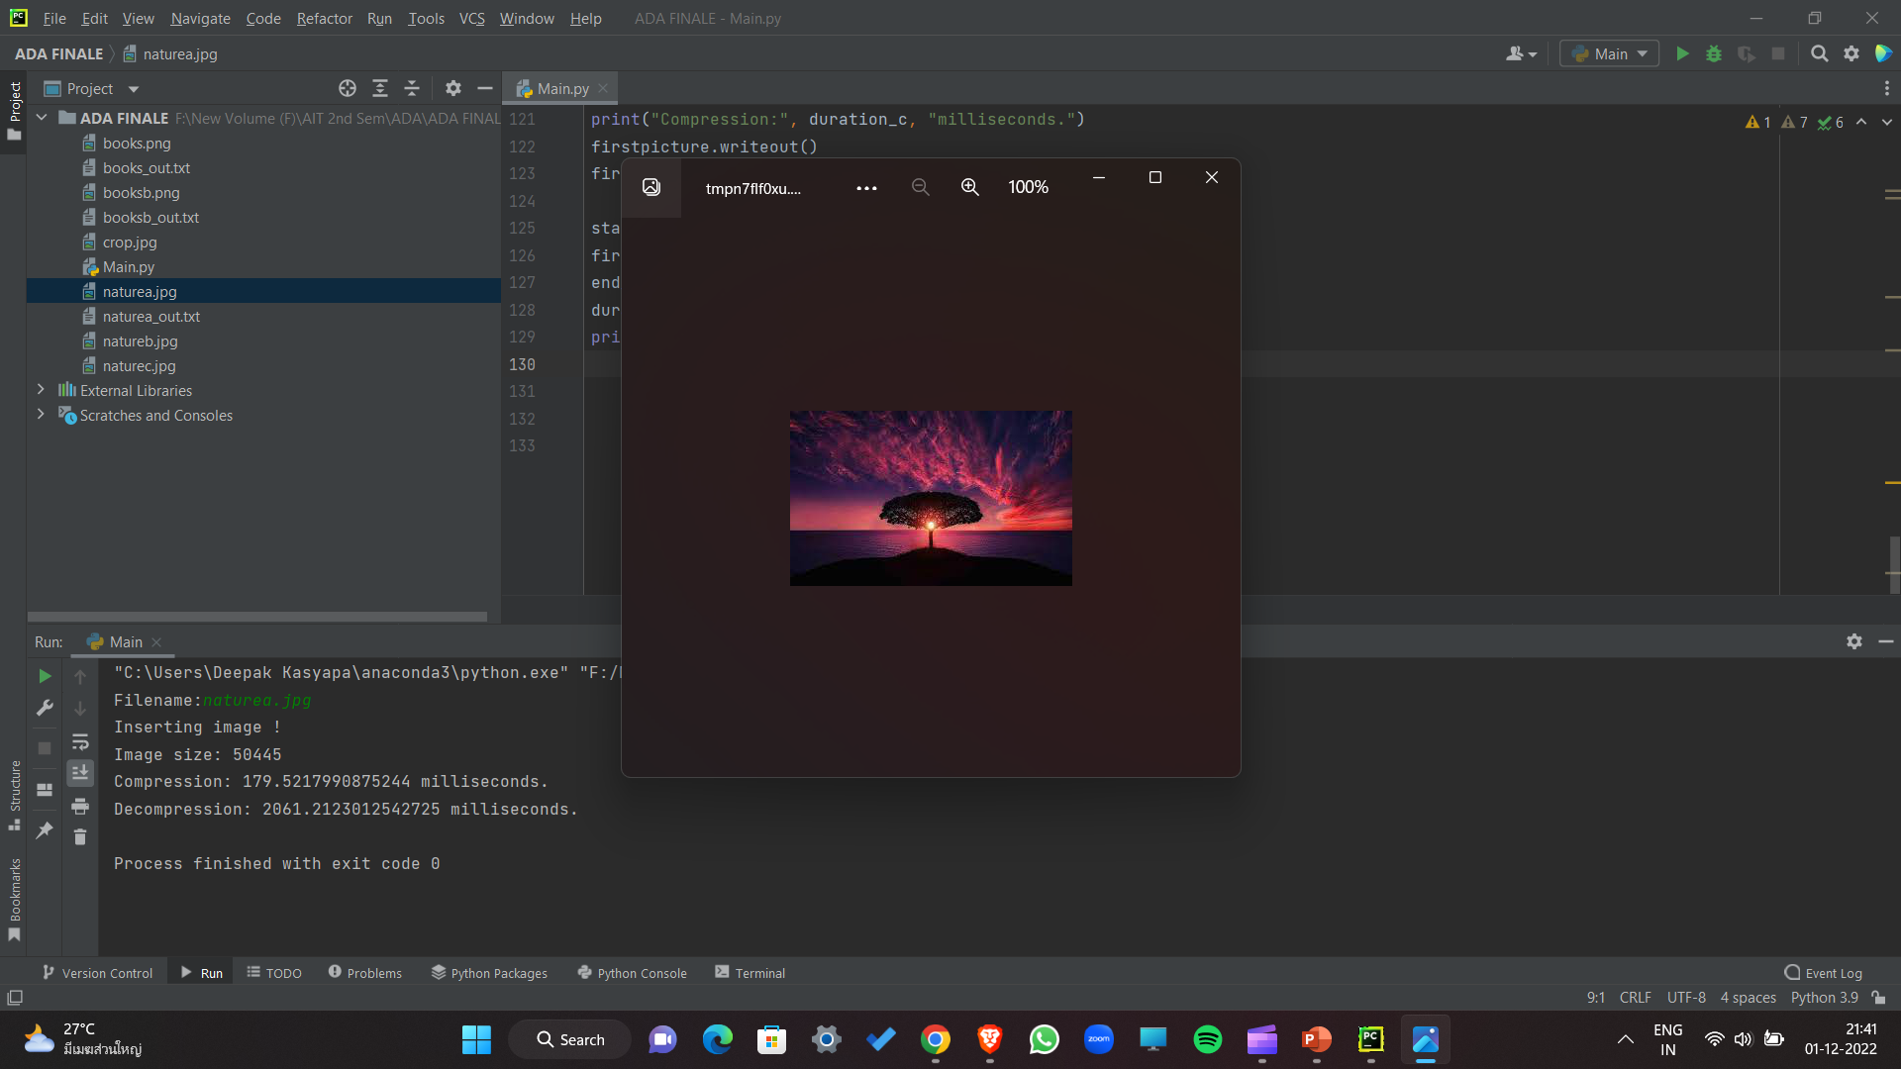

Slide 20
We can see the Text File Generated

Slide 21
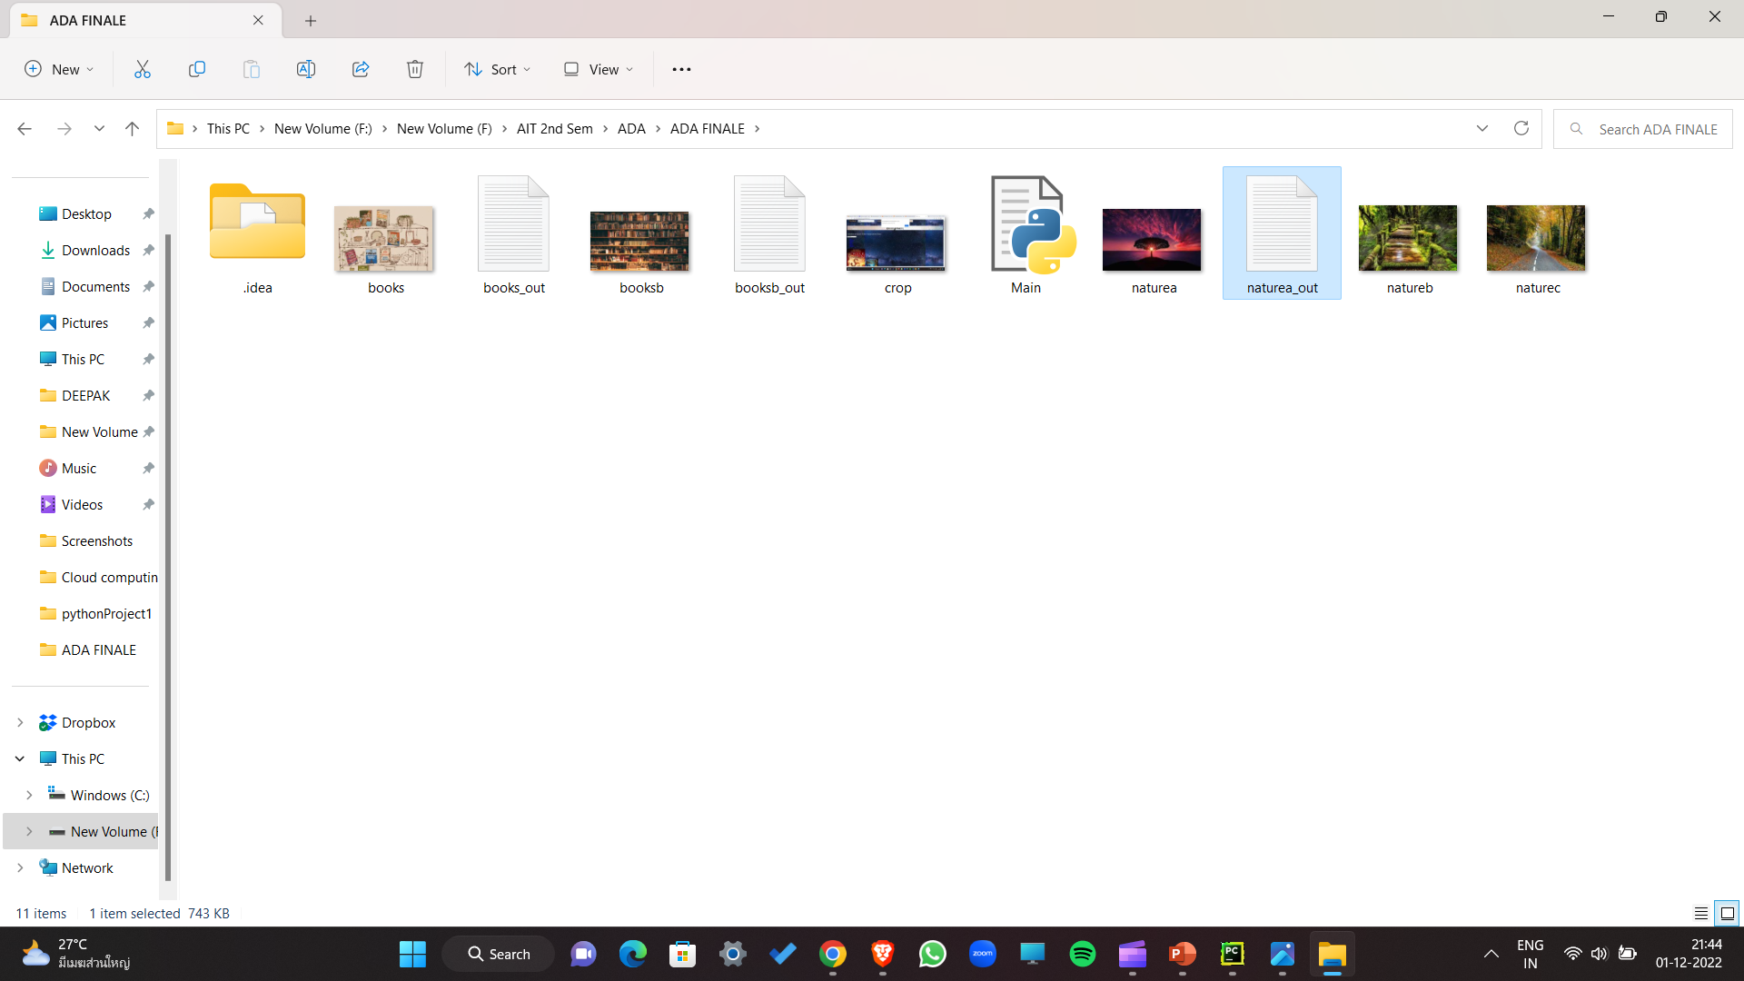

Slide 22
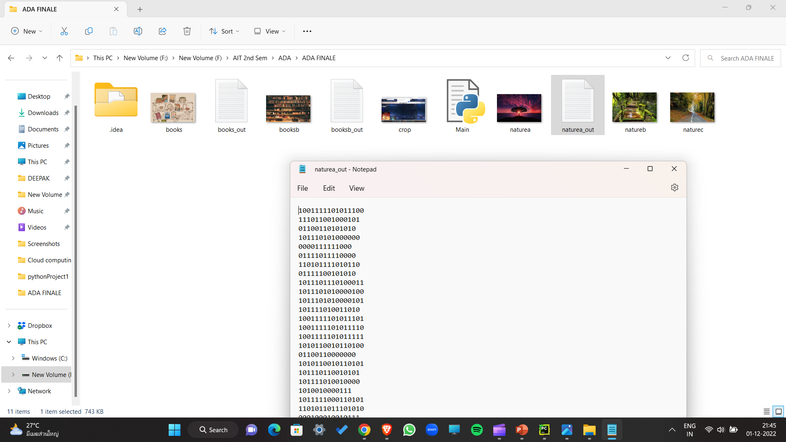

Slide 23
Hence , the image is Compressed and outputs the Text File with compressed data.

Slide 24
Future work
Improve near-lossless technique for enhancing the Quality of the image
Try to Enhance the Efficiency

Slide 25
References:
https://www.geeksforgeeks.org/text-file-compression-and-decompression-using-huffman-coding/?ref=rp
https://tutorialspoint.dev/computer-science/advanced-computer-subjects/image-compression-using-huffman-coding

Slide 26
Thank You
st122891

